Slide 1

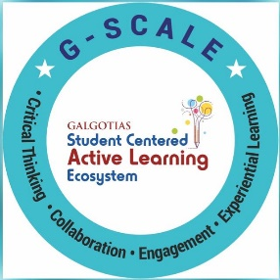
History of ML and ML Life Cycle
Session No.: 03
Course Name: Machine Learning
Course Code: R1UC525B
Instructor Name: Dr. Sivakumar Madeshwaran
Duration: 50 Minutes
Date of Conduction of Class: 12-08-2026

Slide 2

Recap
1) Which of the following is considered the foundation of a Machine Learning system?
a) Function Approximation
b) Training Data
c) Concept Representation
d) Model Deployment
2) In Machine Learning, concept representation mainly refers to:
a) The way models map real-world inputs to outputs
b) The structure of knowledge such as features, rules, or weights
c) The process of tuning hyper parameters
d) The collection of raw datasets
3) A spam detection model is trained on emails collected only from one company. What problem may occur?
a) The model will generalize well to all kinds of emails.
b) The model may fail on new domains due to biased training data.
c) The function approximation will automatically adjust for missing diversity.
d) The prediction stage will fix the bias.

Slide 3
Recap
1) Which of the following is considered the foundation of a Machine Learning system?
a) Function Approximation
b) Training Data
c) Concept Representation
d) Model Deployment
2) In Machine Learning, concept representation mainly refers to:
a) The way models map real-world inputs to outputs
b) The structure of knowledge such as features, rules, or weights
c) The process of tuning hyper parameters
d) The collection of raw datasets
3) A spam detection model is trained on emails collected only from one company. What problem may occur?
a) The model will generalize well to all kinds of emails.
b) The model may fail on new domains due to biased training data.
c) The function approximation will automatically adjust for missing diversity.
d) The prediction stage will fix the bias.

Slide 4
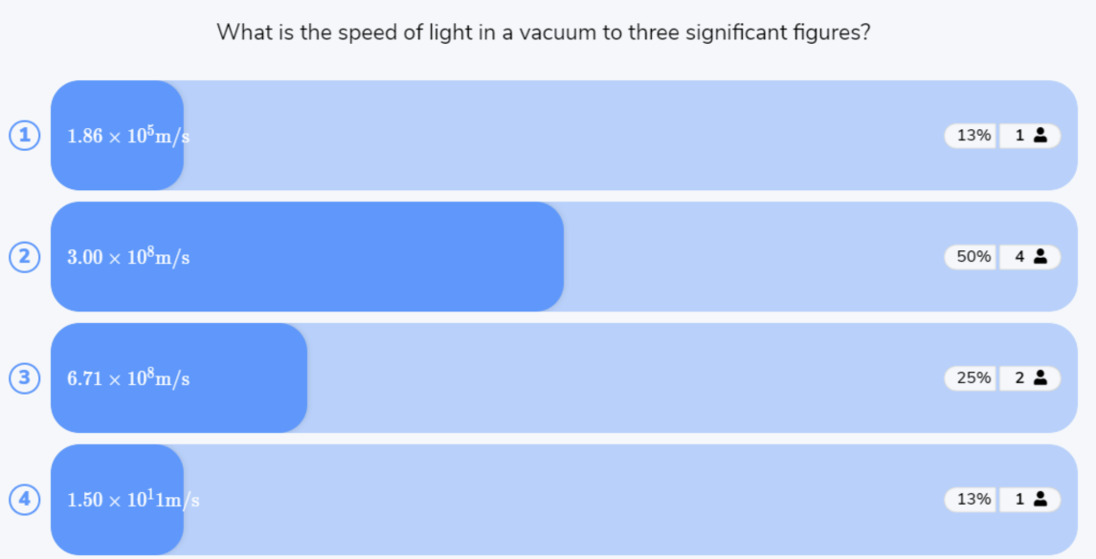
Reflect on the responses of post session activity

Slide 5




How has Machine Learning changed from the past to today, and what are the main steps in developing an ML model?
Opening Question

Slide 6
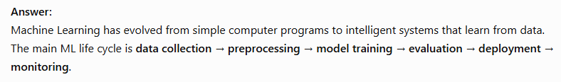
Opening Question -Reflections

Slide 7
At the end of this session students will be able to
LO1: Explain the key milestones in the history of Machine Learing
LO2: Apply the Machine Learning Life Cycle

Slide 8
Session Outline
1 History of Machine learning
2 Activity-1 (Gallery Walk)
3 Life Cycle of Machine Learning
4 Activity-2 (Quiz on Wooflash)
5 Review and Reflections

Slide 9
History of Machine Learning (ML)
Machine Learning has evolved over decades, combining statistics, mathematics, and computer science. Here’s a quick timeline:
1950s – Foundations
Alan Turing (1950): Proposed the Turing Test to evaluate machine intelligence.
Arthur Samuel (1952): Developed a program to play checkers that improved as it played — one of the first ML programs.
Frank Rosenblatt (1957): Introduced the Perceptron, an early neural network.
1960s–1970s – Early AI
Introduction of statistical models and pattern recognition.
Nearest Neighbor algorithms developed.
Limited computational power restricted progress.

Slide 10
History of Machine Learning (ML)
1980s – Rise of Algorithms
Back propagation rediscovered (important for training neural networks).
Development of decision trees and expert systems.
Symbolic AI vs. statistical learning approaches debated.
1990s – Data-driven ML
Emergence of Support Vector Machines (SVMs).
Probabilistic graphical models (e.g., Bayesian networks).
ML starts being applied in real-world domains (finance, medicine, speech recognition).
2000s – Big Data Era
With the internet, vast amounts of data became available.
Ensemble methods like Random Forests and Gradient Boosting became popular.

Slide 11
History of Machine Learning (ML)
2010s – Deep Learning Revolution
2012: AlexNet (Deep Neural Network) won ImageNet challenge → huge leap in computer vision.
Breakthroughs in NLP, speech, reinforcement learning (e.g., Google DeepMind’s AlphaGo).
2020s – Current Trends
Transformers (BERT(Bidirectional Encoder Representations from Transformers), GPT(Generative Pre-trained Transformer), etc.) reformed NLP.
Widespread use of ML in healthcare, self-driving cars, recommendation systems, and generative AI.
Focus on explainable AI (XAI), fairness, and ethics.

Slide 12
Activity 1
Gallery Walk
“Machine Learning looks very advanced today with ChatGPT and deep learning. But how do you think ML in the 1950s, like the first checkers-playing program or the Perceptron, compares to today’s systems?”
Arrange historical milestones of ML in the correct order.

Slide 13
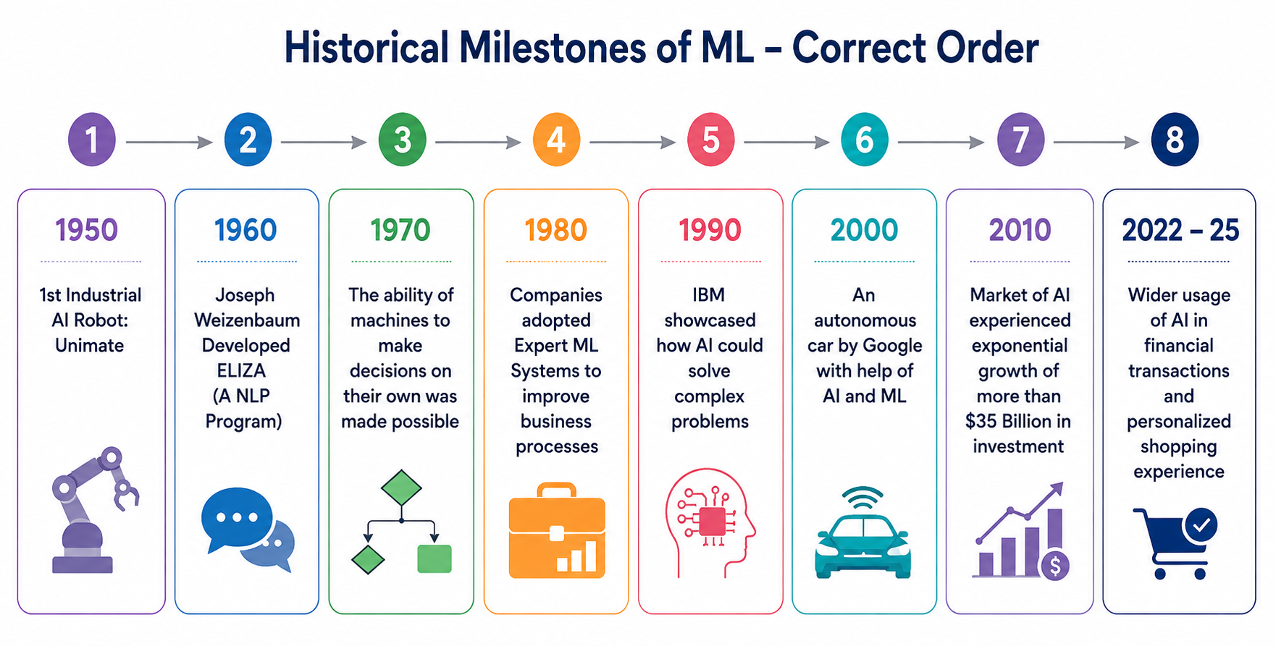
Activity 1
Gallery Walk - Reflections

Slide 14
Machine Learning Lifecycle
Machine Learning lifecycle is a structured process with crucial steps for developing and deploying models, enabling complex problem-solving, data-driven insights, and creation of scalable, sustainable solutions.
The steps are:
Problem Definition
Data Collection
Data Cleaning and Pre-processing
Exploratory Data Analysis (EDA)
Feature Engineering and Selection
Model Selection
Model Training
Model Evaluation and Tuning
Model Deployment
Model Monitoring and Maintenance

Slide 15
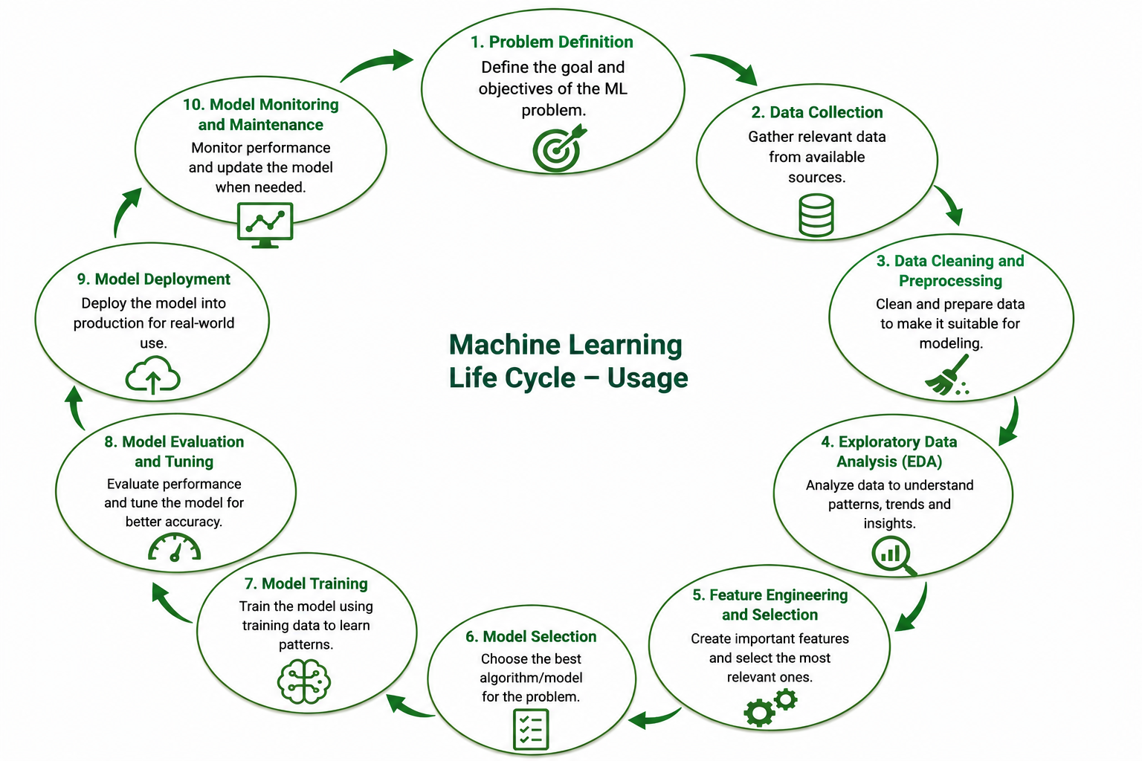
Machine Learning Lifecycle

Slide 16
Machine Learning Lifecycle
Step 1: Problem Definition
In this initial phase we need to identify the business problem and frame it. By framing the problem in a comprehensive manner, team can establishes foundation for machine learning lifecycle. Crucial elements such as project objectives, desired outcomes and the scope of the task are carefully designed during this stage.
Step 2: Data Collection
After Problem Definition, ML lifecycle moves to Data Collection—systematic gathering of raw datasets. Data quality, diversity, and relevance impact robustness and generalization. A well-organized approach ensures effective training, evaluation, deployment, and accurate models for real-world applications.

Slide 17
Machine Learning Lifecycle
Step 3: Data Cleaning and Pre-processing
With datasets ready, we perform Data Cleaning & Pre-processing. Raw data is messy; issues like missing values, outliers, and inconsistencies reduce accuracy. Standardization, scaling, and encoding refine data, ensuring high-quality, reliable input for effective analysis and training.
Step 4: Exploratory Data Analysis (EDA)
Exploratory Data Analysis (EDA) reveals patterns, trends, and insights hidden in data. Using visualizations, EDA provides clear statistical summaries, guiding feature engineering, model selection, and decisions. It helps uncover valuable relationships essential for building effective machine learning models.

Slide 18
Machine Learning Lifecycle
Step 5: Feature Engineering and Selection
Feature Engineering & Selection refines data by choosing relevant variables and creating new features from existing ones. This process, guided by domain expertise, improves accuracy, enhances model efficiency, and reduces computational complexity, ensuring meaningful contributions to prediction.
Step 6: Model Selection
Model Selection is crucial for aligning the algorithm with the problem and dataset characteristics. The choice depends on data nature, problem complexity, and desired outcomes, determining the right framework for accurate and effective prediction.

Slide 19
Machine Learning Lifecycle
Step 7: Model Training
With the chosen model, the lifecycle advances to Model Training, where algorithms learn patterns and relationships from historical data. Through iterative parameter tuning, the model minimizes errors, improves accuracy, and ensures reliable predictions on new, unseen real-world data.
Step 8: Model Evaluation and Tuning
Model Evaluation tests performance on validation/test data using metrics like accuracy, precision, recall, and F1-score. It reveals model strengths and weaknesses, guiding hyperparameter tuning in an iterative cycle to ensure robustness, reliability, and improved predictive accuracy

Slide 20
Machine Learning Lifecycle
Step 9: Model Deployment
Model Deployment integrates the trained model into real-world systems, enabling informed decision-making. It delivers practical solutions to business needs while requiring continuous monitoring and adjustments to maintain effectiveness, ensuring theoretical insights transform into impactful applications.
Step10. Model Monitoring and Maintenance
Model Monitoring & Maintenance ensures deployed models remain accurate and reliable over time. By tracking performance, detecting concept drift, and applying updates/retraining, this phase supports continuous improvement, sustaining model effectiveness in dynamic real-world environments.

Slide 21

Activity 2:Quiz in Wooclap

Slide 22
Summary
1 History of Machine learning
2 Activity-1 (Gallery Walk)
3 Life Cycle of Machine Learning
4 Activity-2 (Quiz on Wooflash)
5 Review and Reflections

Slide 23
Ensure attainment of LOs in alignment to the learning activities: outcomes (1-2)
LO1: Explain the key milestones in the history of Machine Learing
LO2: Apply the Machine Learning Life Cycle

Slide 24

Post Session Activity

Slide 25
Information about the next lesson
Performance metrics overview

Slide 26


Review and Reflection from students

